Slide 1
Introduction to computer vision
A tech talk by Maarten Knaepen

Slide 2
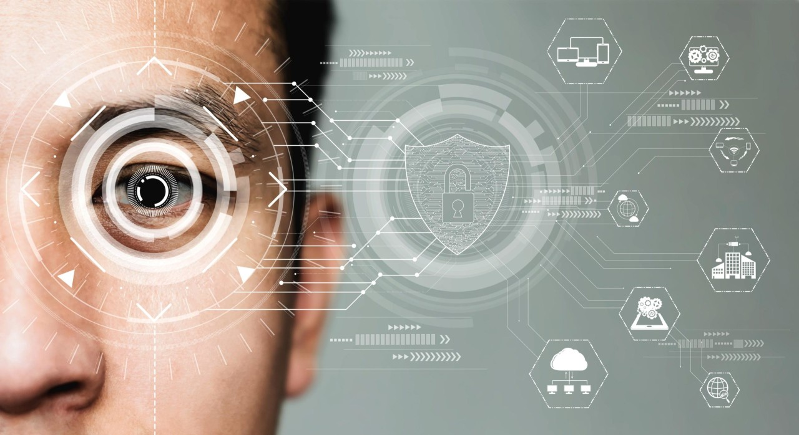
Overview
Machine Learning
Neural Network
Stochastic Gradient Descent (SGD)
Machine Learning Limitations
Computer Vision Tutorial
What our image recognizer learned
Image classifiers can handle non-image tasks
Deep learning for more than image classification

Slide 3
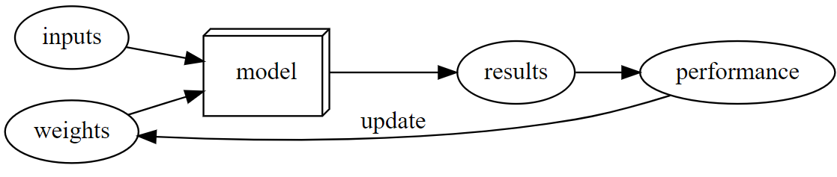
Machine Learning
Machine learning encompasses techniques like deep learning, utilizing neural networks dating back to the 1950s.
Machine learning allows computers to learn from examples to complete tasks.
Machine learning involves weight assignments, model parameters that define how the program operates.
Automatic testing of performance and mechanisms for adjusting weights optimize the model's performance over time.
The training loop involves feeding inputs to the model, evaluating its performance, and updating weights accordingly.

Slide 4
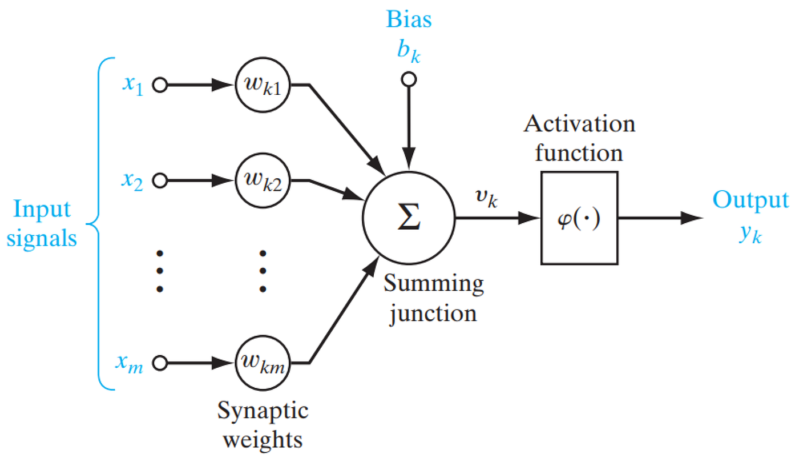
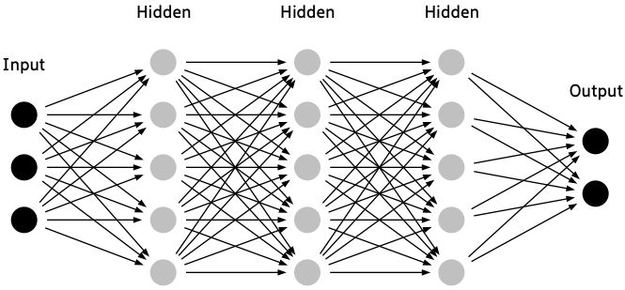
Neural Networks
Versatile models used for various tasks like image recognition and text understanding.
Flexible mathematical functions whose behavior is determined by their weights.
Training neural networks involves finding optimal weight assignments through processes like stochastic gradient descent (SGD).
SGD provides a general method for updating weights, enabling neural networks to improve at various tasks automatically.
Inputs are data like images, with weights determining the network's behavior.
Results are the output produced by the network, classifications like “bird" or “forest."
Performance is evaluated based on accuracy of predicted outcomes.

Slide 5
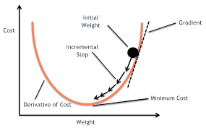
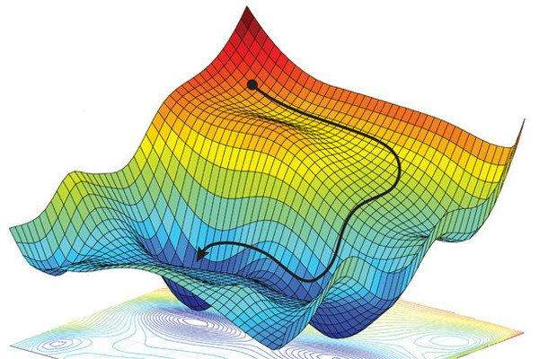
Stochastic Gradient Descent (SGD)
Essential optimization algorithm for ML model training.
Updates model parameters iteratively to minimize loss.
Computes gradients using mini-batches, making it efficient for large datasets.
Randomness from mini-batch selection helps in escaping local minima.
Adjusts parameters in direction reducing loss.
Learning rate crucial for convergence and stability.
Requires hyperparameter tuning for effective use.

Slide 6
Machine Learning Limitations
Data is essential for creating a model.
Models learn only from patterns in input data.
Machine learning models generate predictions, not recommended actions.
Labeled data is crucial for effective model training.
Gap exists between organizational goals and model capabilities due to prediction limitations.
Predictive models may reinforce biases present in training data, leading to feedback loops.
Feedback loops can perpetuate biases and distort model performance over time.

Slide 7
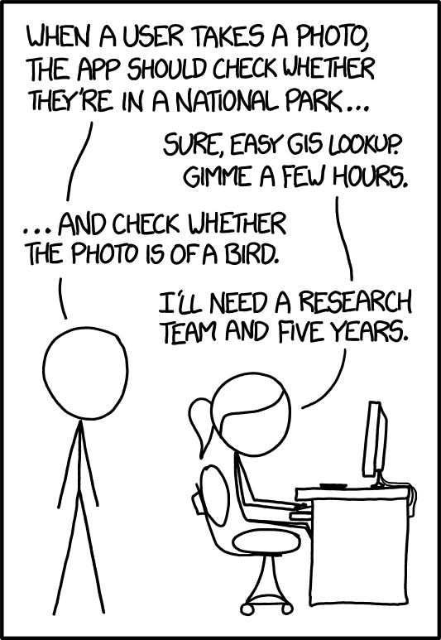
Image Classifier Tutorial
https://github.com/MaartenKnaepen/Intro-to-computer-vision

Slide 8
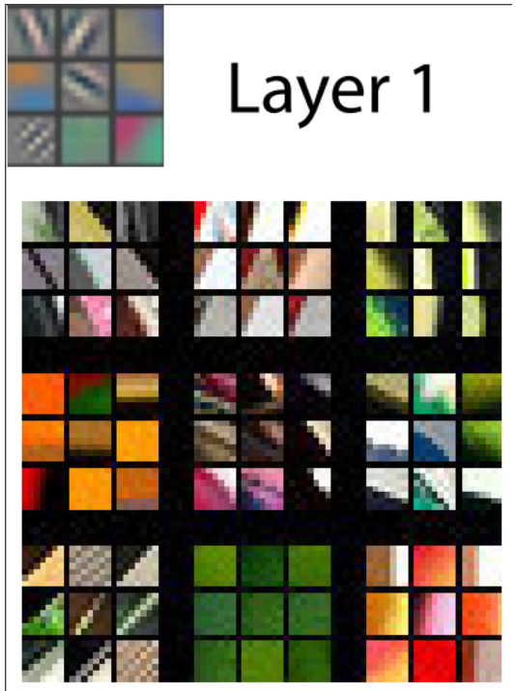
What our Image Recognizer Learned
Deep learning models often appear as "black box" models
Research exists on how to interpret and understand them
Visualizing neural network weights provides insights into model behavior
In layer 1, the model learns to detect diagonal, horizontal, and vertical edges, along with various gradients.
These learned features serve as basic building blocks for computer vision tasks and resemble human visual perception and handcrafted computer vision features.

Slide 9
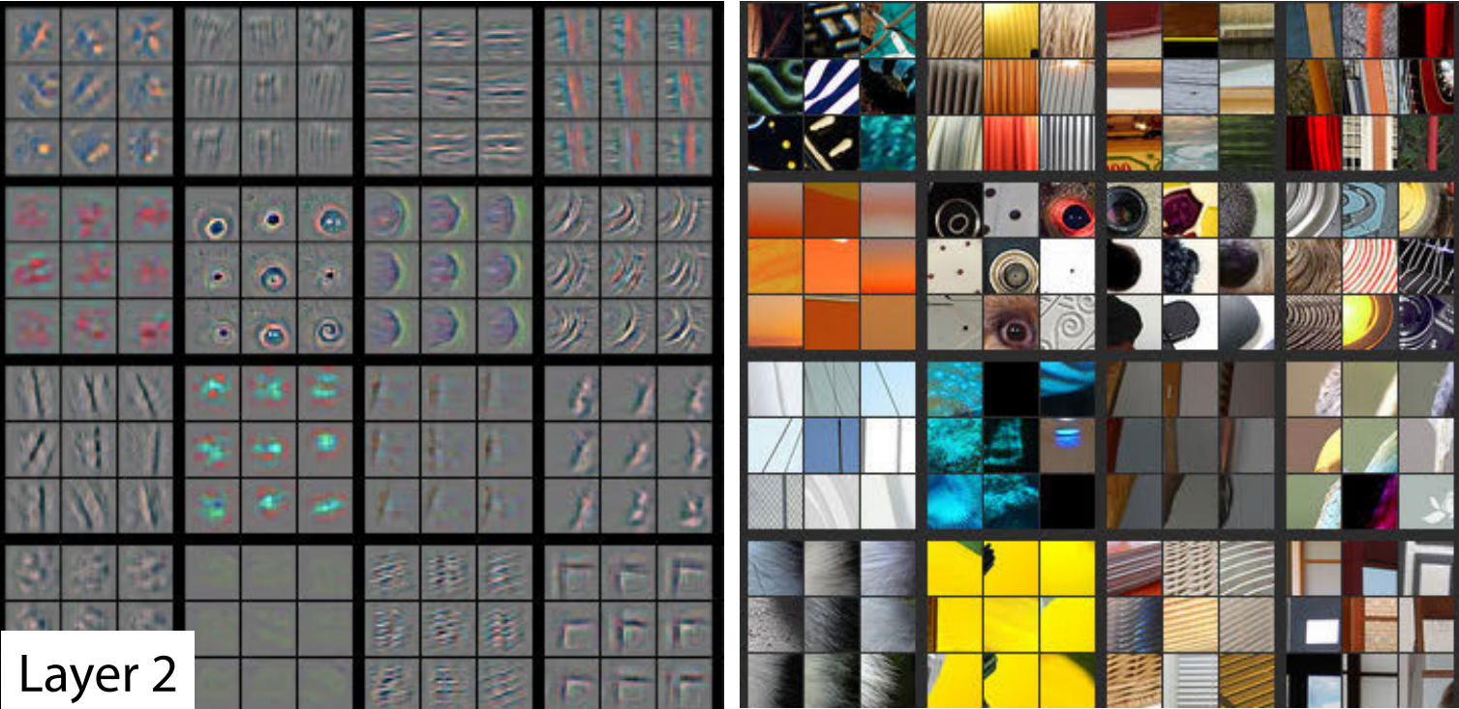
What our Image Recognizer Learned
Layer 2 features: Detect corners, lines, circles, and patterns, built from layer 1 building blocks.
Corresponding patches from actual images illustrate feature matches, like gradients and textures seen in sunsets.

Slide 10
What our Image Recognizer Learned
Layer 2 features: Detect corners, lines, circles, and patterns, built from layer 1 building blocks.
Corresponding patches from actual images illustrate feature matches, like gradients and textures seen in sunsets.

Slide 11
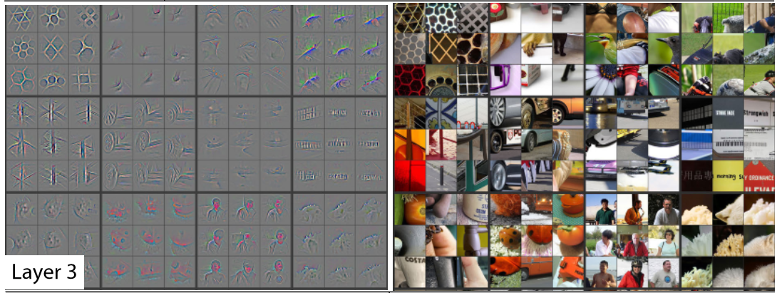
What our Image Recognizer Learned
Righthand side of the picture: Features identify higher-level semantic components like car wheels, text, and flower petals.

Slide 12
What our Image Recognizer Learned
Righthand side of the picture: Features identify higher-level semantic components like car wheels, text, and flower petals.

Slide 13
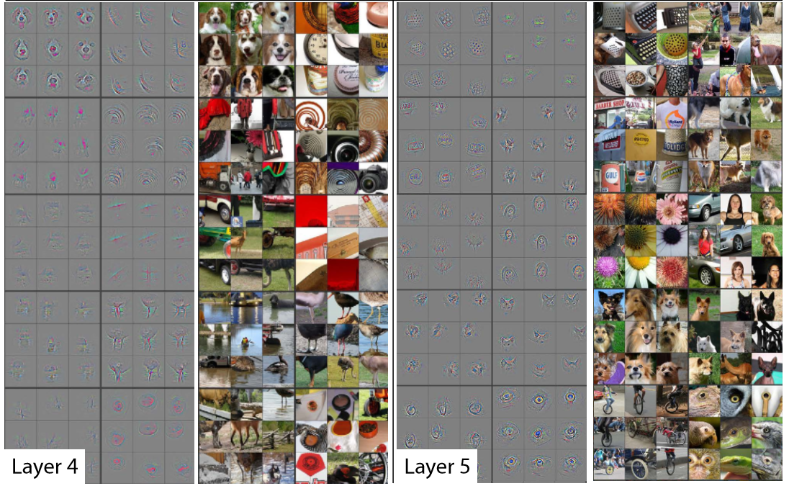
What our Image Recognizer Learned
Layers 4 and 5 recognize higher-level concepts

Slide 14
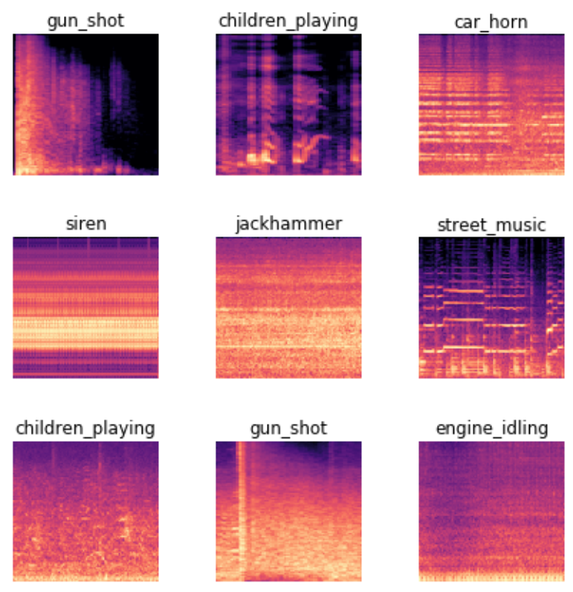
Image recognizers can handle non-image tasks
Image recognizers can perform diverse tasks by representing various data types as images.
Sound can be converted into spectrograms for analysis by image recognition models.
Spectrograms display unique patterns for different sounds, aiding in accurate classification.

Slide 15
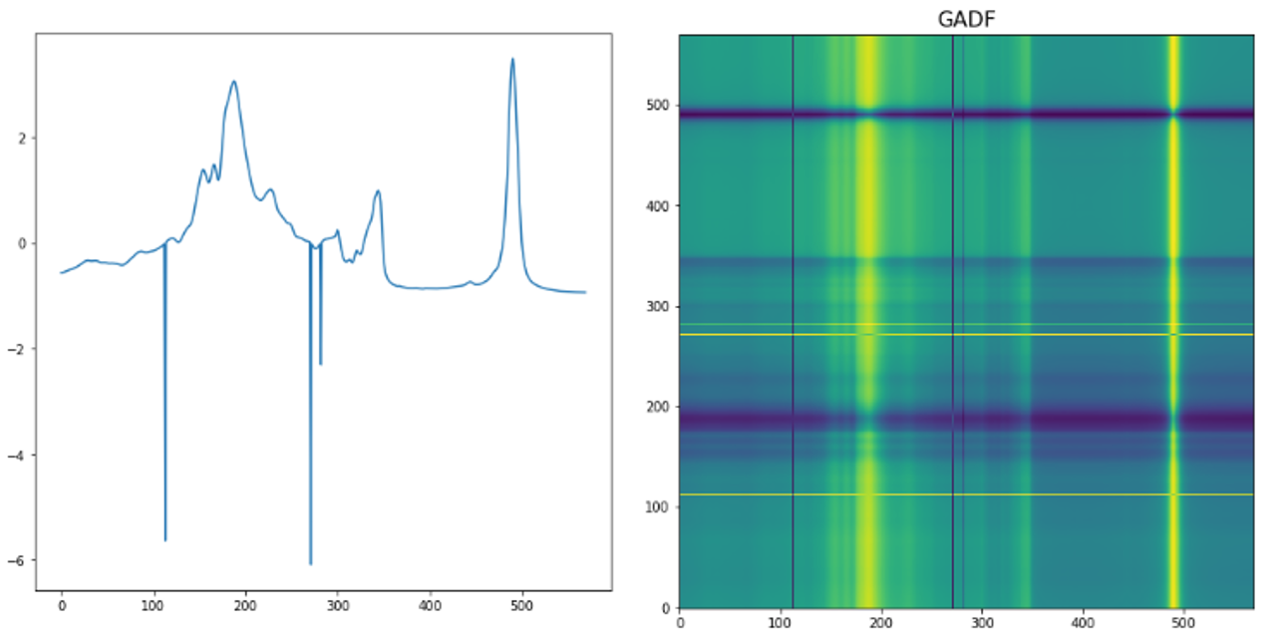
Image recognizers can handle non-image tasks
Time series can be plotted as images to emphasize key components like seasonality and anomalies.
Usage of GADF to convert time series data into images for olive oil classification.
These images were then analyzed using image classification models.

Slide 16
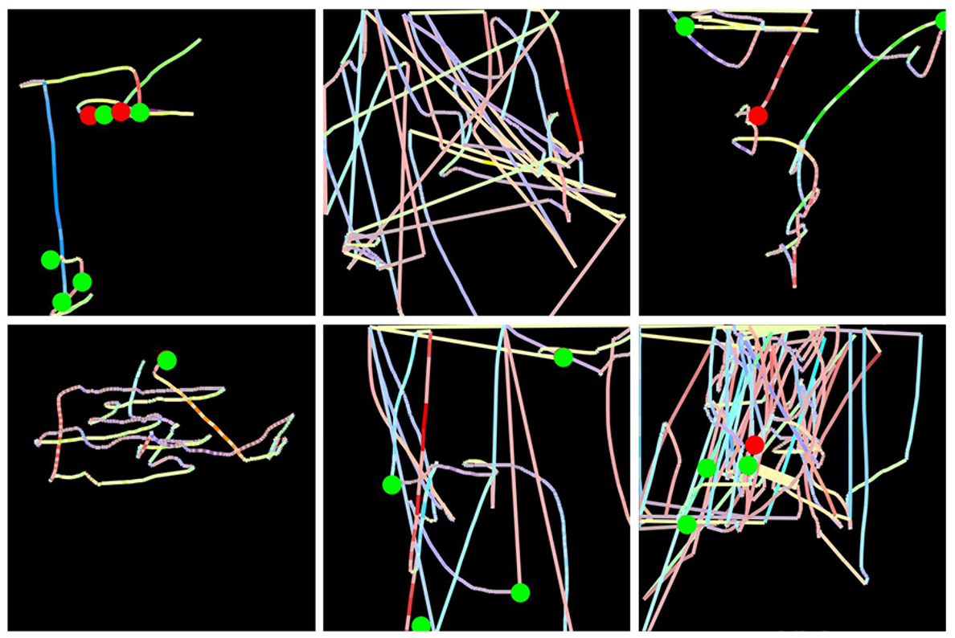
Image recognizers can handle non-image tasks
Mouse movement and click data were utilized for fraud detection at Splunk.
The data was transformed into images displaying mouse pointer details and clicks using colored lines and circles.
Analysis with an image recognition model led to a successful fraud detection approach, resulting in a patent.

Slide 17
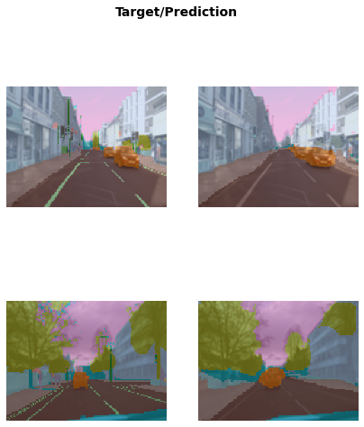
Deep learning for more than image classification
Object localization ➔ autonomous vehicles
Segmentation models identify objects in images with precision
These models achieve accurate pixel-level classification, effectively delineating objects such as cars and trees.

Slide 18
Questions?

